Slide 1

Mobile Application Development, Fall 2021 Introduction to State Management Part 2

Slide 2
Today’s Agenda
Finishing the Color App
State and Props: Color Adjuster App

Slide 3
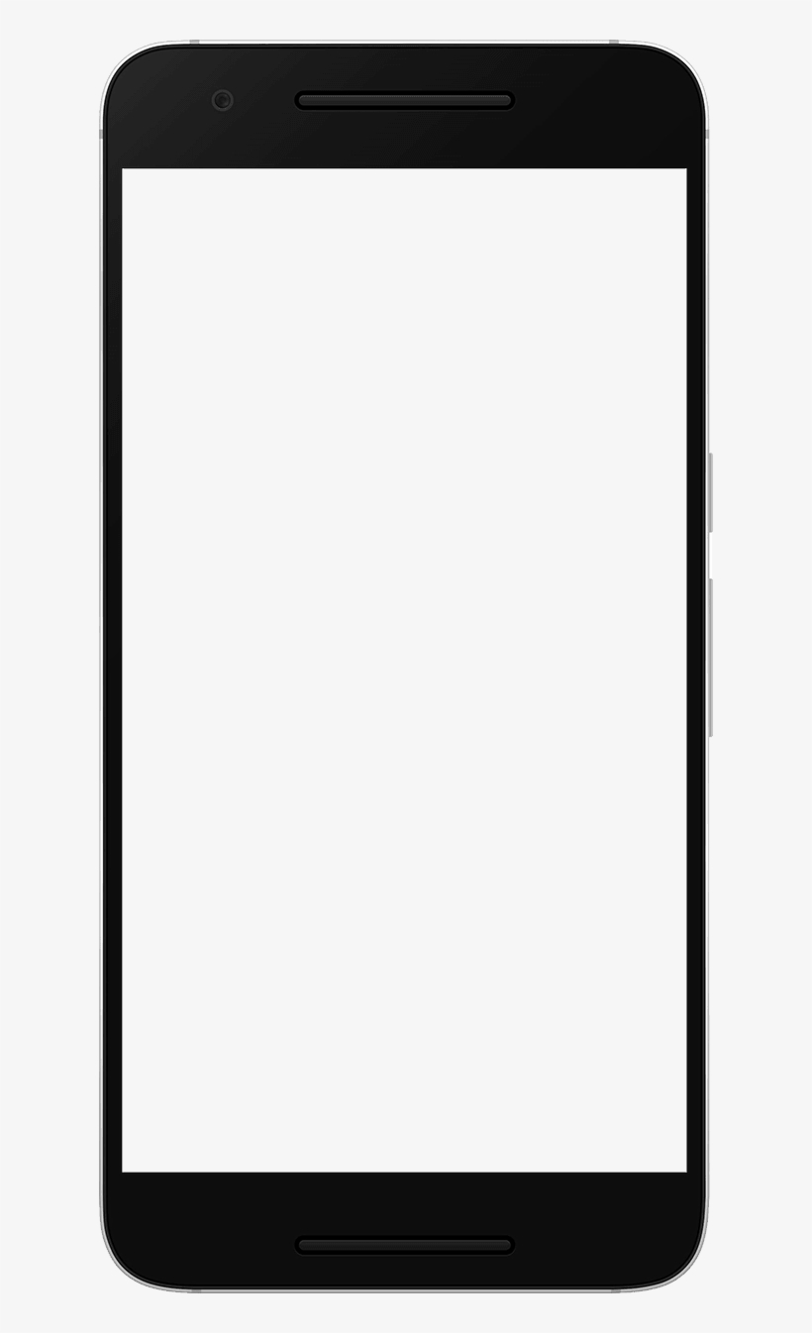
Finishing the Color App
Add Color
So, when last we spoke, we had the aim of a little app like this!
Using our cool new useState hook!
To make the app rerender whenever we changed a piece of state that we identified!
rgb(0,0,0)
rgb(0,0,0)
rgb(0,0,0)
rgb(0,0,0)

Slide 4
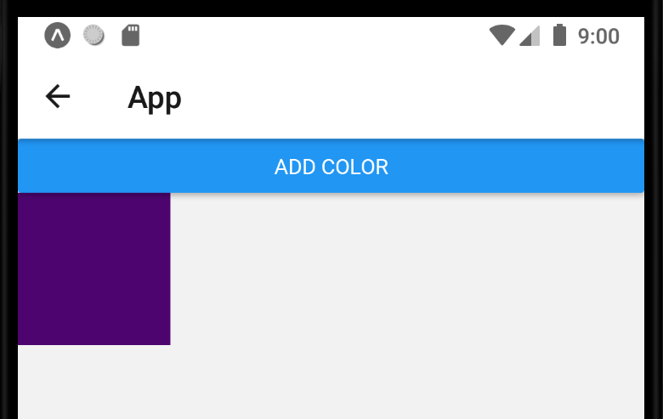
Finishing the Color App
We basically got to this point, where an app is capable of generating a square with a random color.
At least on the surface!

Slide 5
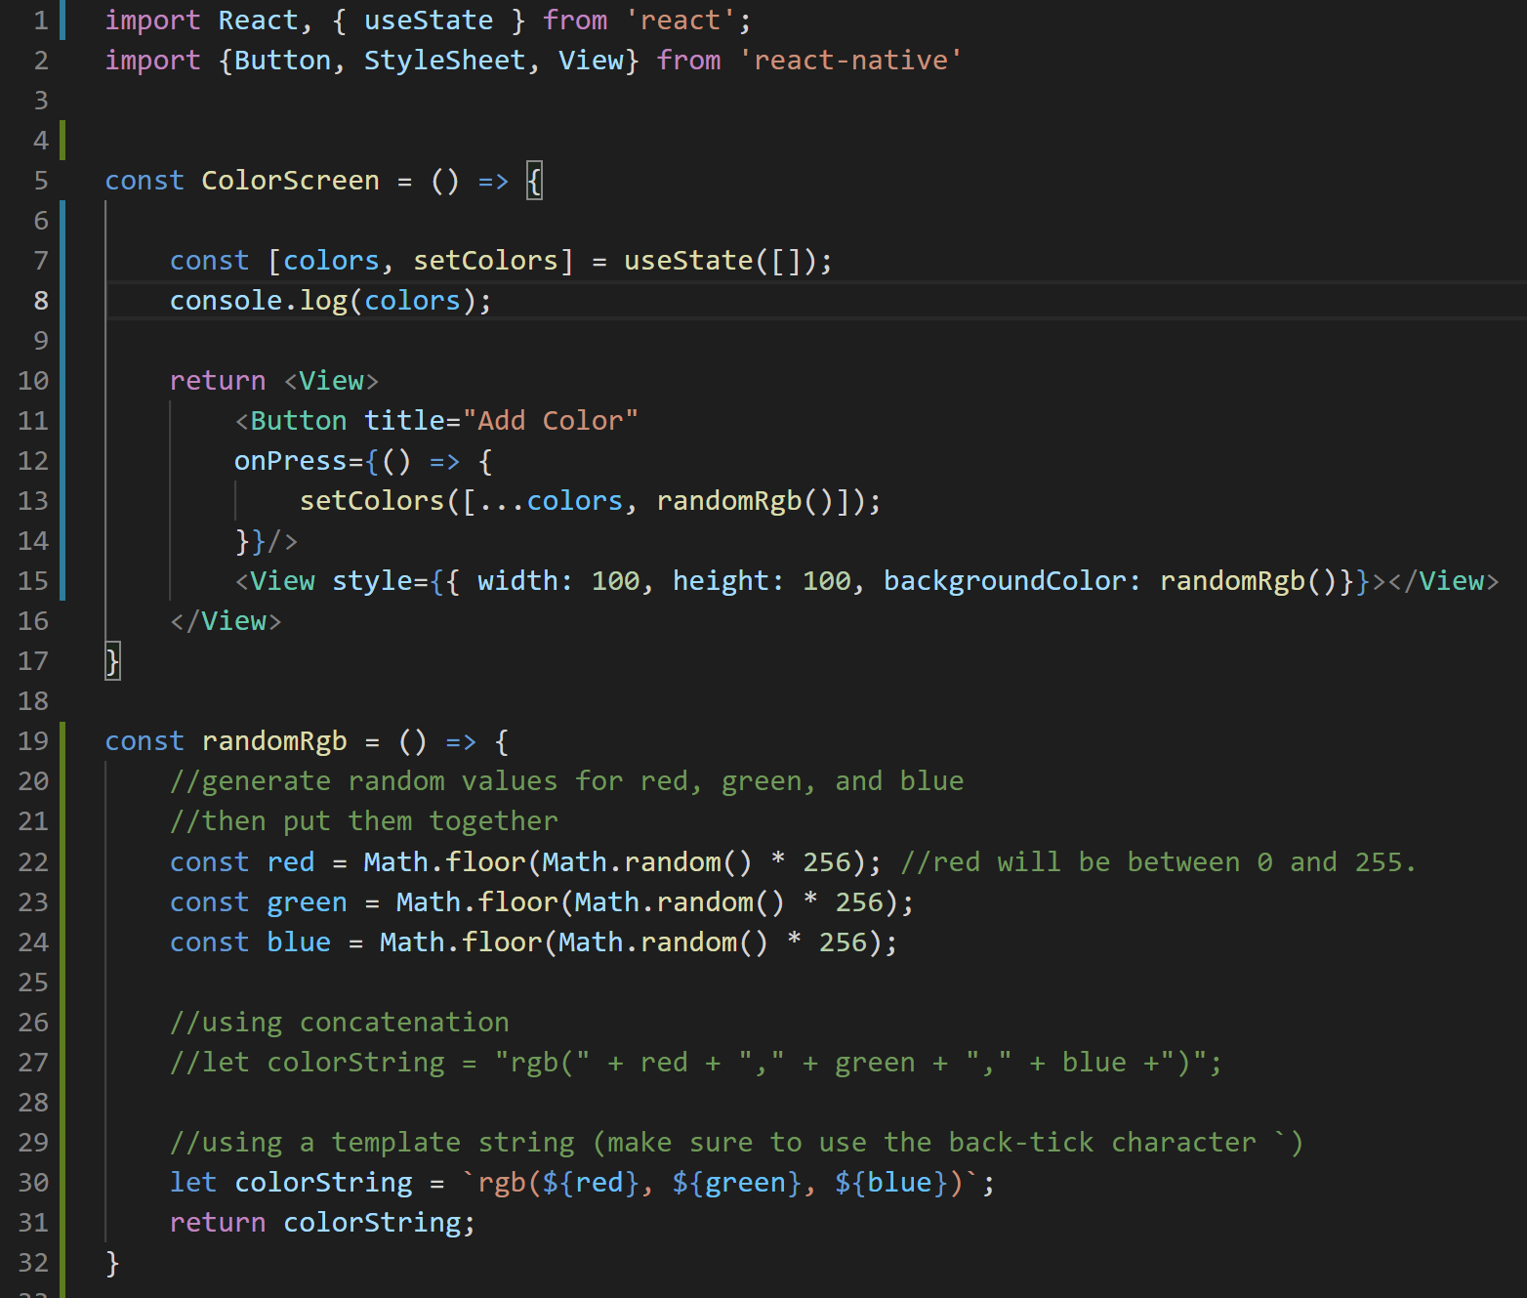



Finishing the Color App
Beneath the surface, our state is actually an array!
And through the use of the setter function provided to us through the useState hook…
And through this nice randomRgb function we made…

Slide 6
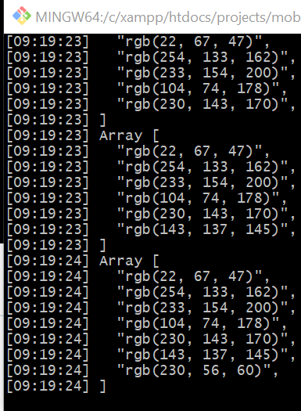
Finishing the Color App
We’ve gotten it to the point where clicking on the “Add Color” button does, in fact, add a color to the array.
But we are still only displaying a single View!
How can we expand this? How can we display a bunch of data in an array?

Slide 7
Finishing the Color App
Add Color
Well, I left you with a hint last time: using the FlatList component!
That’s the one we used to display the list of teacher names way back when!
rgb(0,0,0)
rgb(0,0,0)
rgb(0,0,0)
rgb(0,0,0)

Slide 8
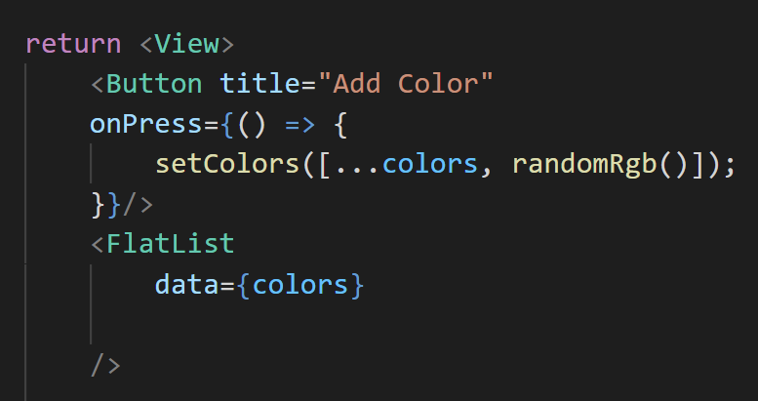

Finishing the Color App
I know it’s been a bit since we’ve touched FlatList, so let’s take a look at what we’ve got here!
We recall that there is the data prop!
This is where we specify the array that has the data that we want to use for our list.
we’ll use the colors we worked so hard to generate here!
ColorScreen.js

Slide 9
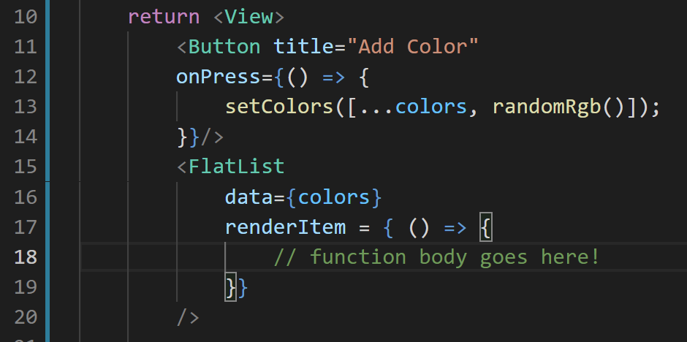
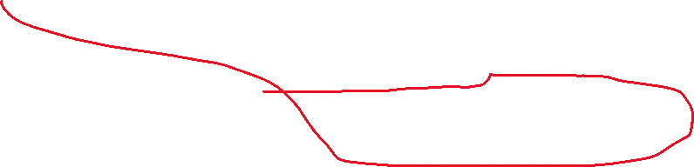
Finishing the Color App
There is also the renderItem prop.
This is a function that let’s us specify how we want each item in our list to be displayed.
We still need to specify the parameter and the function body.
ColorScreen.js

Slide 10
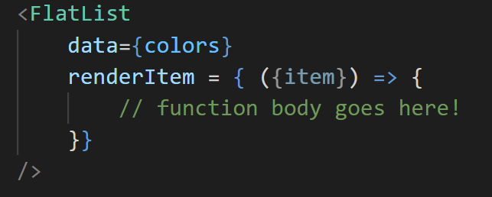
Finishing the Color App
For the parameter, you’ll write to use
{item}
Recall that in this context, the { } is destructuring the object that would naturally get passed in to that function, only looking at the item property.
By just looking at item, we get just the part that we care about! the rgb string!
ColorScreen.js

Slide 11
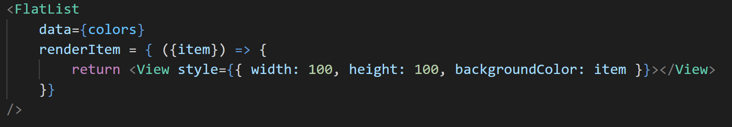
Finishing the Color App
ColorScreen.js
And then for the body of the renderItem function, we want to return JSX that represents how we want that item to look!
Here, we want any given element in our colors array to be displayed as a View component, with a width and height of 100.
And note how we specify the backgroundColor to be item, i.e., the color that corresponds to the element in the data array we are looking at.

Slide 12
Finishing the Color App
ColorScreen.js
At this point, we would have an app that basically does what we want it to do…
BUT – is FlatList going to be happy about it?

Slide 13
Finishing the Color App
ColorScreen.js
Probably not!
Because remember: it likes that key extractor!
The keys need to be…
strings
consistent across renders
unique
Thankfully, the rgb for each color is *definitely* a string, and *definitely* consistent!
And although there’s a CHANCE it won’t be unique, it’s, uh, probably going to be unique enough for our purposes.
So let’s just use that!

Slide 14
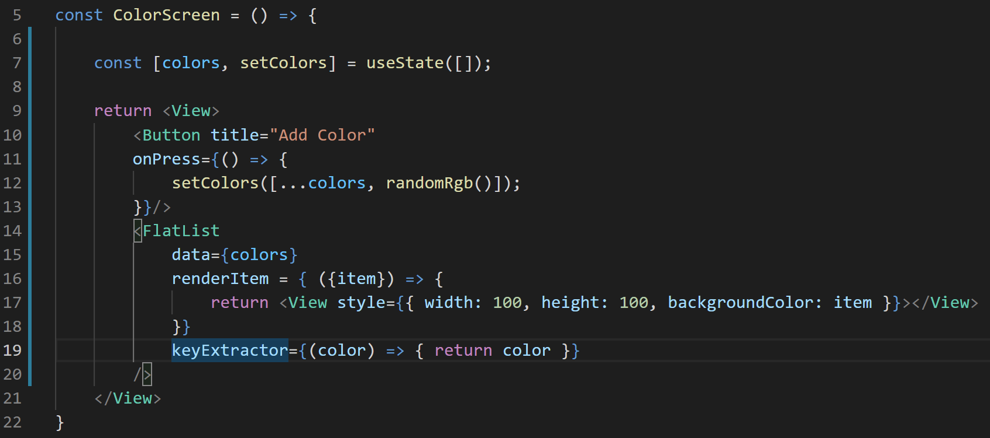
Finishing the Color App
ColorScreen.js
And recall that with the keyExtractor, there’s no need for destructuring.
It’s just going to have the element in question, which here is our string values of the form rgb(x,x,x)
So let’s just return it right back, to use as the element’s key!

Slide 15
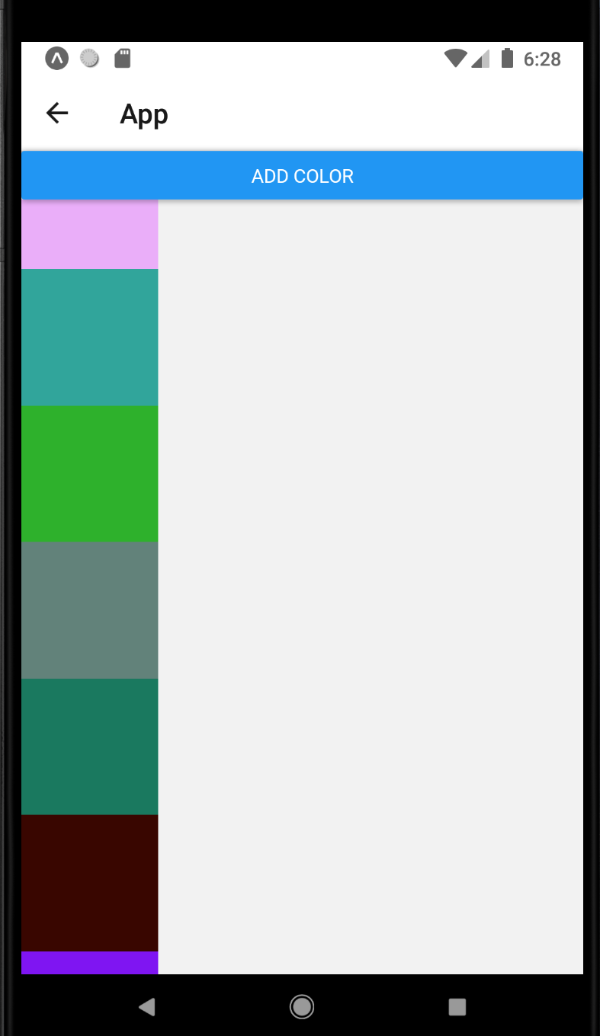
Finishing the Color App
And what we have now should look a little something like this!
An app that when you click ‘add color’ it, well, adds a color!
And don’t forget: React Native automatically adds the scrollbar, so you can scroll if your boxes start going off the edge of the screen!

Slide 16
Finishing the Color App
So great!
We’ve gotten another state example under our belts!
And we learned a little something about colors to boot!
We’re going to look at yet another state example now, but this one is going to start leveraging both state AND props together.

Slide 17
Today’s Agenda
Finishing the Color App
State and Props: Color Adjuster Apps

Slide 18
State and Props: Color Adjuster App
We’re going to make yet another app.
This one is will build off of several things that we’ve seen already.
And of course, introduce new concepts
including some of the relationship between state and props.

Slide 19
State and Props: Color Adjuster App
Red
More Red
We’re going to make yet another app.
This one is will build off of several things that we’ve seen already.
And of course, introduce new concepts
including some of the relationship between state and props.
Less Red
Green
More Green
Less Green
Blue
More Blue
Less Blue

Slide 20
State and Props: Color Adjuster App
Red
More Red
It’s going to be a “color adjuster” app!
It will have one square, and by clicking buttons, you can adjust how much red, green, and blue makes up it’s background color.
Less Red
Green
More Green
Less Green
Blue
More Blue
Less Blue

Slide 21
State and Props: Color Adjuster App
Red
More Red
And maybe you are already thinking about this, but just in case…
I want to draw your attention to the fact that most of this looks pretty similar right?
Less Red
Green
More Green
Less Green
Blue
More Blue
Less Blue

Slide 22



State and Props: Color Adjuster App
Red
More Red
It’s basically the same thing three times, just with slightly different text!
Seems like it is going to be another great opportunity to make use of reusable components!
So, something to look forward to.
Less Red
Green
More Green
Less Green
Blue
More Blue
Less Blue

Slide 23
State and Props: Color Adjuster App
Red
More Red
Let’s ask our questions again!
1.) What piece of data is changing in this app?
This time: three different pieces of state (red, green,blue)
2.) What is the type of the changing data?
numbers
3.) What is the data’s starting value?
Probably 0 or 255 are reasonable!
Less Red
Green
More Green
Less Green
Blue
More Blue
Less Blue

Slide 24
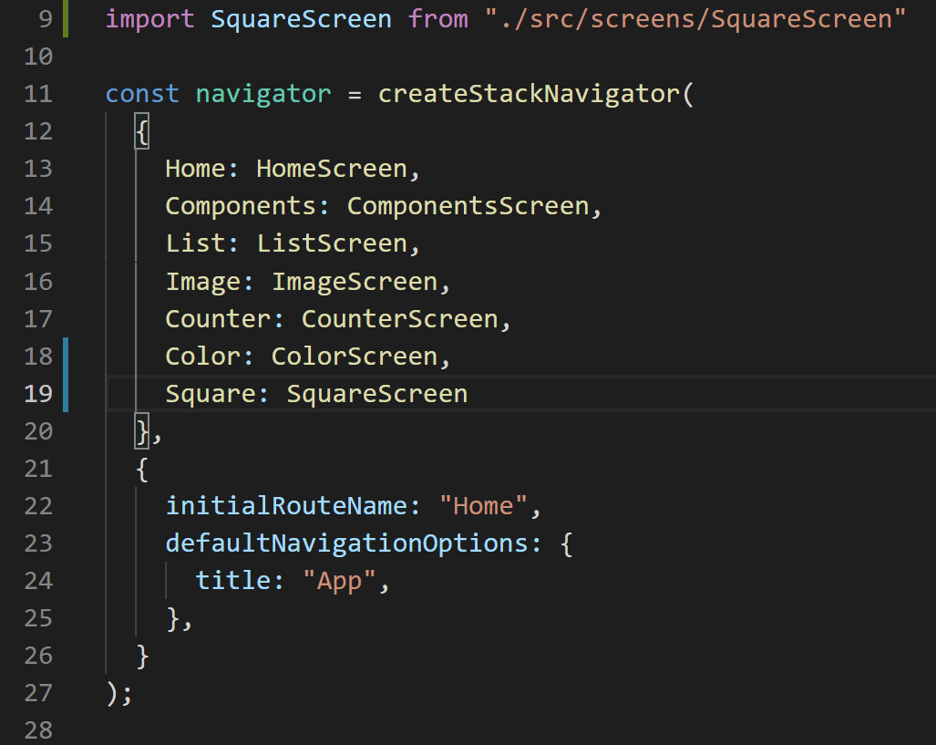
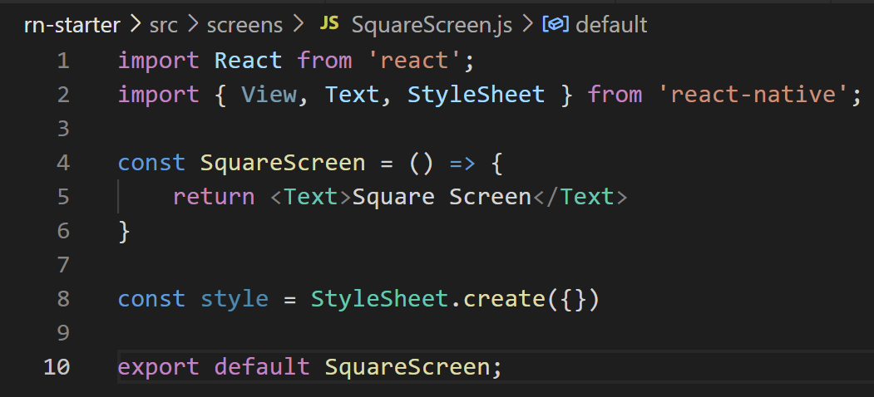
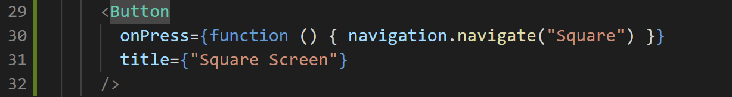
State and Props: Color Adjuster App
And let’s also add the boilerplate stuff we know and love!
A new screen for this new app!
Maybe “SquareScreen.js” since it just has one square?
Import the screen and add it to the list of route names in App.js!
Add a new button for it on the home screen!

Slide 25
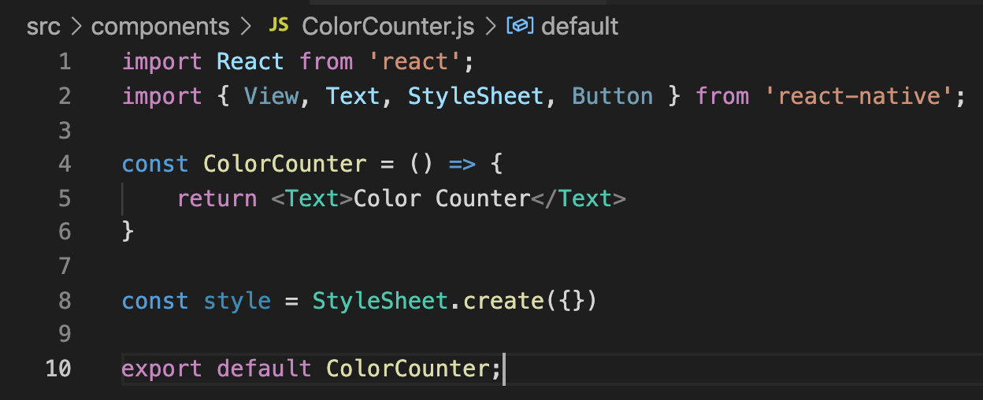
State and Props: Color Adjuster App
ColorCounter.js
And we recall that in order to make those reusable components…
We need to make a file for those to!
So we can use that exact same boilerplate code we just made and put it into a new file.
Maybe call it ColorCounter.js
Since it is basically counting how much of any given color will be present.

Slide 26
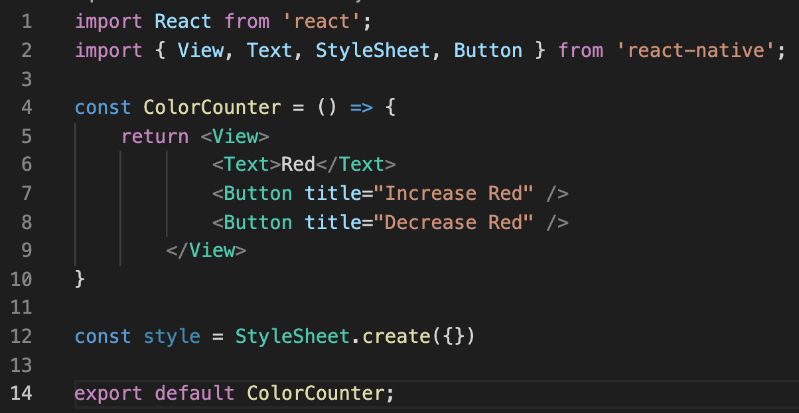
State and Props: Color Adjuster App
Red
More Red
Less Red
Green
More Green
Less Green
Blue
More Blue
Less Blue
ColorCounter.js
And in fact, we can make a first pass at what should go in here!
A text element and two button elements!
We can customize it with props in just a second!

Slide 27
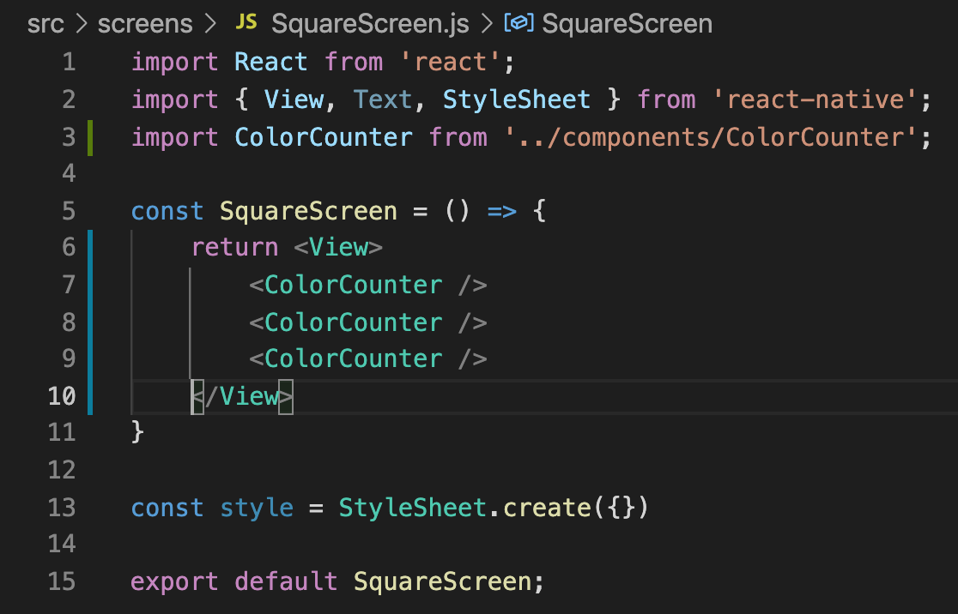

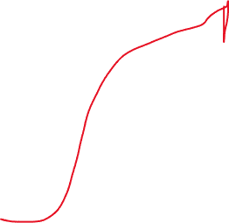
State and Props: Color Adjuster App
And with that, we then start using it!
We import ColorCounter from wherever you saved the file.
Probably the components folder, if your structure matches mine!
And then you just use it!
SquareScreen.js

Slide 28
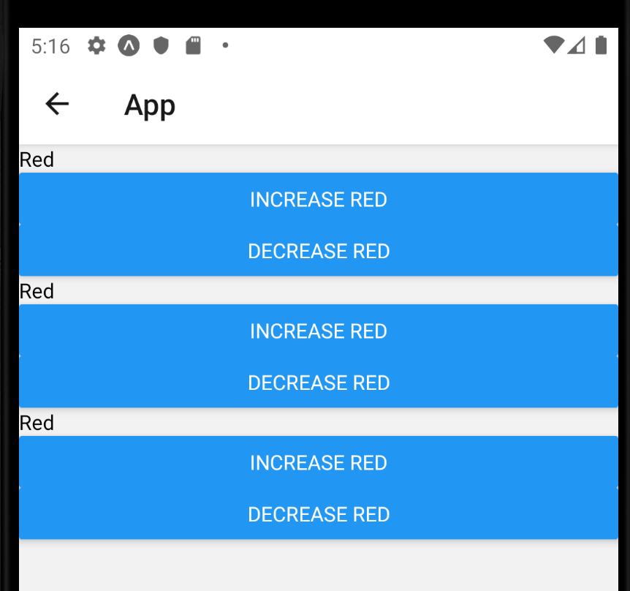
State and Props: Color Adjuster App
This should result in an app that looks like this!
Of course it all says red because we hard coded it!
Do you remember how to configure these components using props?

Slide 29
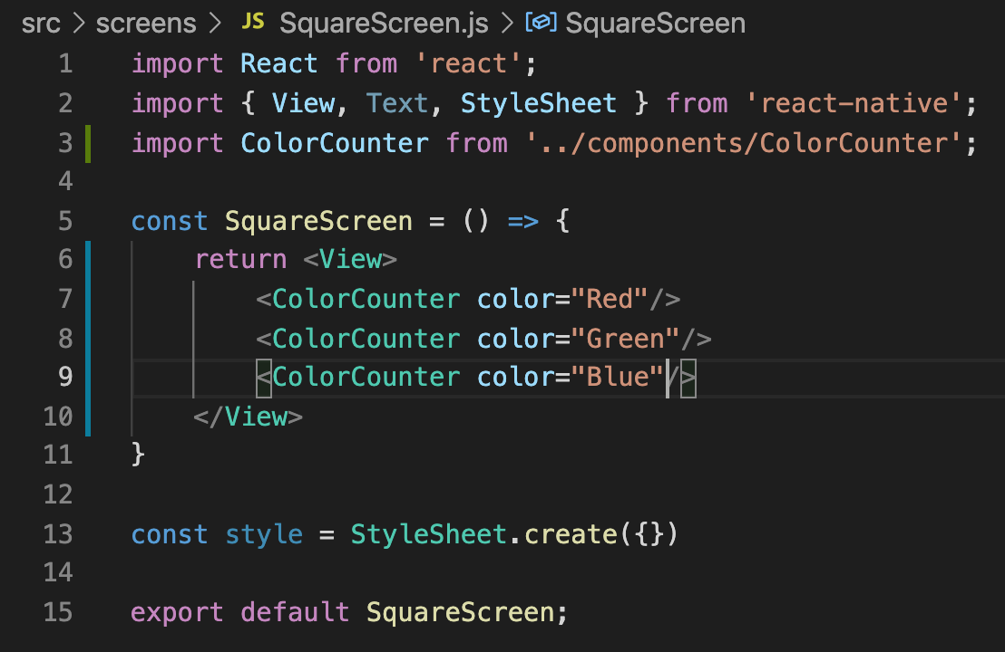
State and Props: Color Adjuster App
First, you need to settle on the name(s) of your props and be consistent across all of your components!
Here, we called the prop color.
We also assigned them each values.
SquareScreen.js

Slide 30
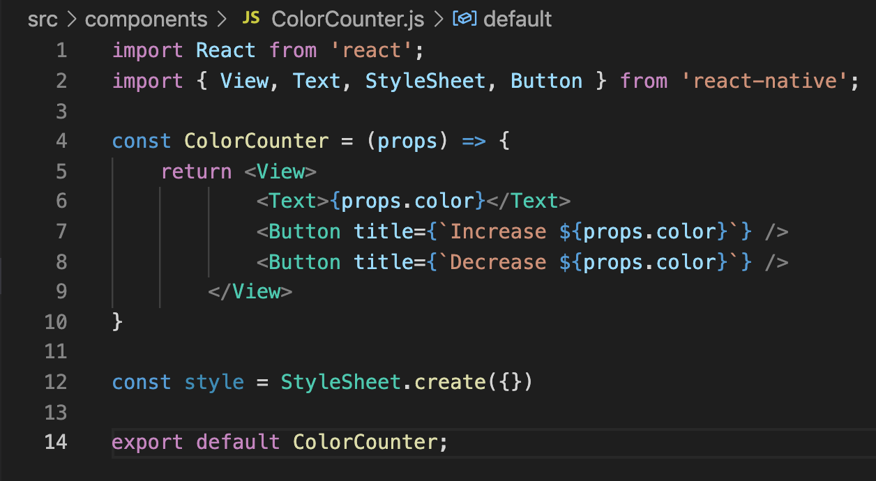

State and Props: Color Adjuster App
And then we can start actually making use of those props in ColorCounter.js!
Remember: first we need to specify a parameter that will store the passed in props.
ColorCounter.js

Slide 31
State and Props: Color Adjuster App
And we recall that the name of the prop we created was “color”.
So to use it, we just type props.color
ColorCounter.js

Slide 32
State and Props: Color Adjuster App
And some quick notes/reminders here:
This is an example of string templating.
So it is using the backtick character ` (same key as ~). Not the apostrophe.
Also, when you do string templating as a prop value, you need to enclose the whole thing in curly braces
{ }
ColorCounter.js

Slide 33
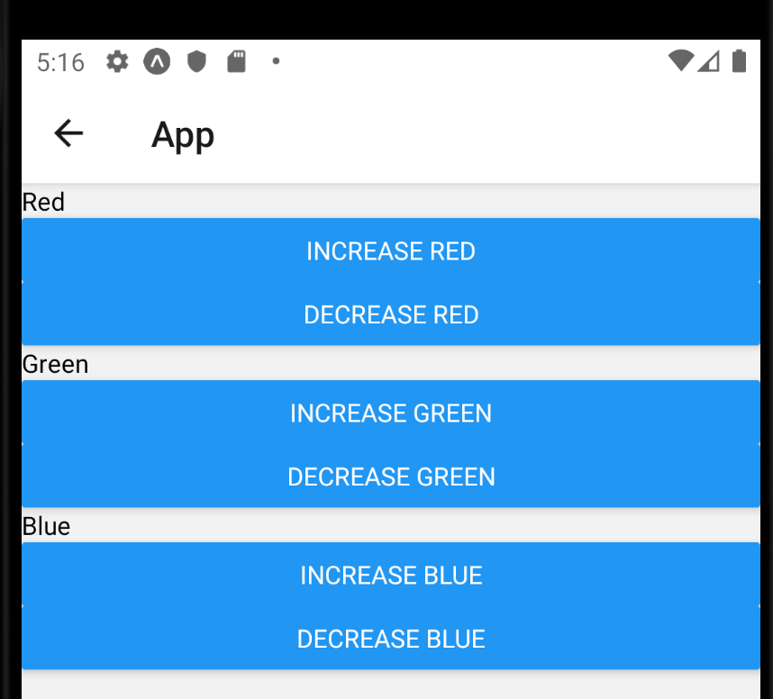
State and Props: Color Adjuster App
And just like that, we’re done!
A thing that before took us an nearly an entire lecture now we can do in like five minutes!
We’re learning! We’re getting better!
But now we’re faced with a question we’ve never had to ponder before…

Slide 34
State and Props: Color Adjuster App
Red
More Red
Less Red
We know that we’re going to need to use this concept of State to keep track of how much Red, how much Green, and how much Blue to color our square in.
But it seems like there are two reasonable places to create that state!
Green
More Green
Less Green
Blue
More Blue
Less Blue

Slide 35

State and Props: Color Adjuster App
Red
More Red
Less Red
Green
More Green
Less Green
Blue
More Blue
Less Blue
ColorCounter.js
We could put it in ColorCounter.js, because that has the buttons that you click that CHANGE the state.

Slide 36
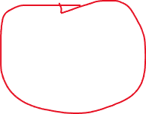
State and Props: Color Adjuster App
Red
More Red
Less Red
Green
More Green
Less Green
Blue
More Blue
Less Blue
SquareScreen.js
Or we could put it in Square Screen because that (presumambly) is what is eventually going to USE those colors!

Slide 37
State and Props: Color Adjuster App
SquareScreen
If we remind ourselves of this little parent-child relationship diagram…
ColorAdjuster
ColorAdjuster
ColorAdjuster

Slide 38

State and Props: Color Adjuster App
SquareScreen
We agreed that the SquareScreen component needs to access, or read from, that state data.
ColorAdjuster
ColorAdjuster
ColorAdjuster

Slide 39

State and Props: Color Adjuster App
SquareScreen
And we agree that these child components are changing the color values i.e., writing to them.
And that the screen itself needs to access those values, i.e., read from them,
ColorAdjuster
ColorAdjuster
ColorAdjuster

Slide 40
State and Props: Color Adjuster App
SquareScreen
The rule of thumb is that we will add the pieces of state as “upstream” as possible.
There are some situations where we won’t!
That is, the parent highest in the hierarchy that reads or writes from the data.
So today, we’ll add this data to SquareScreen.
ColorAdjuster
ColorAdjuster
ColorAdjuster

Slide 41
State and Props: Color Adjuster App
SquareScreen
So great! We’ve made that decision!
But now we need to face the consequences of that decision: how will our ColorAdjuster components access that variable?
Well, it depends if the child component needs to *read* the state data, or *write to* the state data.
i.e., simply “use it”, or actually “change it”
ColorAdjuster
ColorAdjuster
ColorAdjuster

Slide 42
State and Props: Color Adjuster App
SquareScreen
If the child components only need to *read* the state data, then we can pass state data down to these components as props.
As promised: state and props mixing together!
Of course, that isn’t the situation we find ourselves in.
ColorAdjuster *does* need to edit the state variable.
{value: “red”}
{value: “green”}
{value: “blue”}
ColorAdjuster
ColorAdjuster
ColorAdjuster

Slide 43
State and Props: Color Adjuster App
SquareScreen
If the child components need to *write* to the state data, then we can pass state down a callback function!
This is the situation we find ourselves in for this example!
{ onChange () => {}}
{ onChange () => {}}
{ onChange () => {}}
ColorAdjuster
ColorAdjuster
ColorAdjuster

Slide 44
State and Props: Color Adjuster App
SquareScreen
Here, the child components can invoke the callback function…
The callback function then tells the parent component that it needs to rerender…
And when a parent component rerenders, all of the child components do too!
{ onChange () => {}}
{ onChange () => {}}
{ onChange () => {}}
ColorAdjuster
ColorAdjuster
ColorAdjuster

Slide 45
State and Props: Color Adjuster App
SquareScreen
Great! We know what’s coming!
But first, now that we’ve established that SquareScreen will use state, let’s set it up to be ready for that!
{ onChange () => {}}
{ onChange () => {}}
{ onChange () => {}}
ColorAdjuster
ColorAdjuster
ColorAdjuster

Slide 46
State and Props: Color Adjuster App
SquareScreen
Great! We know what’s coming!
But first, now that we’ve established that SquareScreen will use state, let’s set it up to be ready for that!
{ onChange () => {}}
{ onChange () => {}}
{ onChange () => {}}
ColorAdjuster
ColorAdjuster
ColorAdjuster

Slide 47
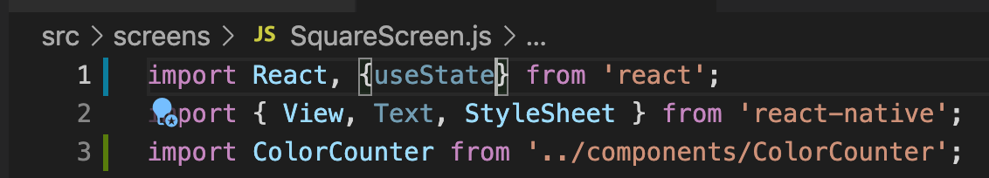
State and Props: Color Adjuster App
SquareScreen.js
First, we import our new friend: the useState hook, from the react library.
Remember: hooks let us add in new functionality to our components!
Next, we’ll do something that is pretty similar to what we saw last time, but different in scale!

Slide 48
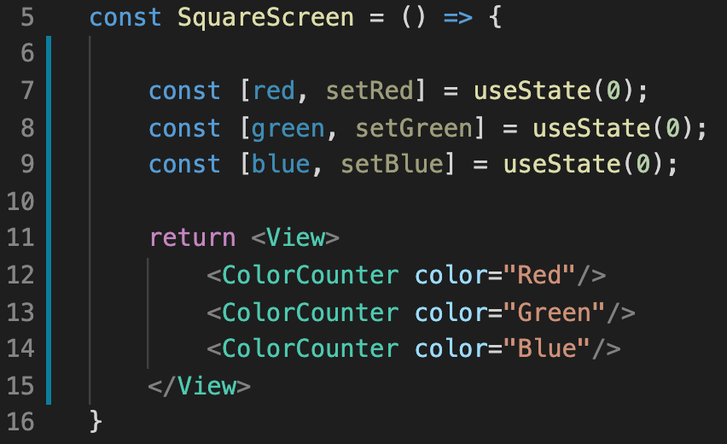

State and Props: Color Adjuster App
We declare not one, but THREE pieces of state!
And remember the parts of this!
useState(0) is us using the hook we just imported, the 0 we are passing in here is the default value of the state.
It returns an array with two elements.
SquareScreen.js

Slide 49
State and Props: Color Adjuster App
And this bit is using Array destructuring to store the elements of the returned away in variables.
red will store the data itself.
Remember: we can never directly change it by changing this variable!
setRed is a setter function
*this* is how we will change the value of red!
SquareScreen.js

Slide 50
State and Props: Color Adjuster App
Quick thought experiment time!
Take 30 seconds and think up the answer to this:
We said that we’ll need to use callback functions if we want child components to change the state.
What would those look like here?
SquareScreen.js

Slide 51
State and Props: Color Adjuster App
Here’s the tricky bit of insight:
Remember, each button needs its own callback function.
And each ColorCounter has two buttons.
One for increase, one for decrease.
So at this stage, we actually need to pass in *two* callback functions!
SquareScreen.js

Slide 52
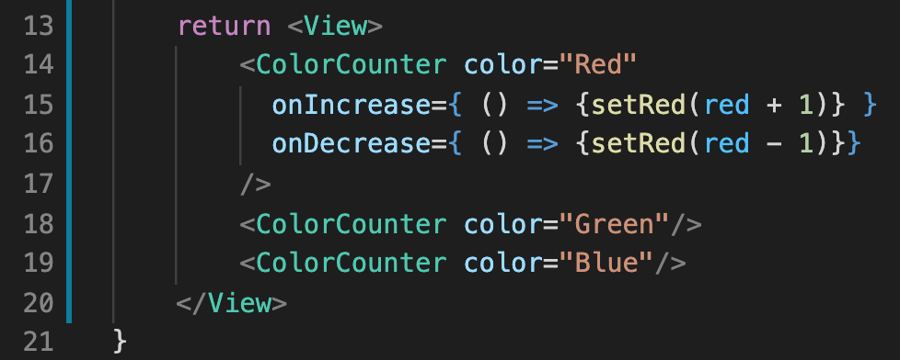
State and Props: Color Adjuster App
Here’s what those callback functions might look like for the red case!
Here, we’re declaring two new props, onIncrease and onDecrease
These are props of our own making, could have called them anything
And these props are both storing functions.
The first function invokes our red setter, passing in the current value of red + 1
The second function decreases it.
SquareScreen.js

Slide 53
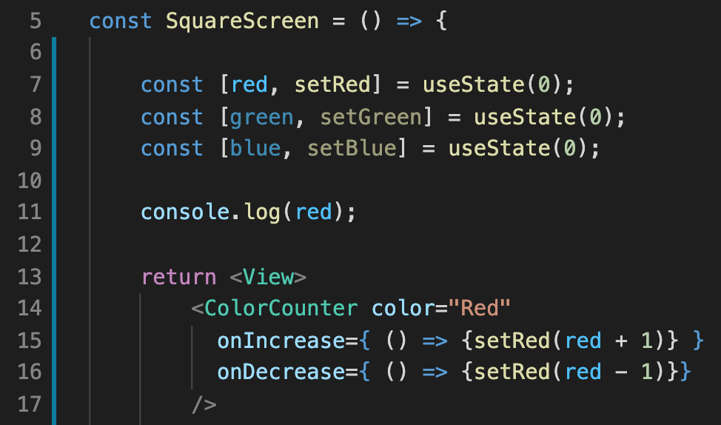

State and Props: Color Adjuster App
Note, this is just us *adding* the functions.
We aren’t invoking them yet!
In general, I would encourage you to get into the habit of printing out variable values.
At least while you are first starting to learn.
BUT, at this moment, red will just always print 0, and only when we first load the screen.
SquareScreen.js

Slide 54
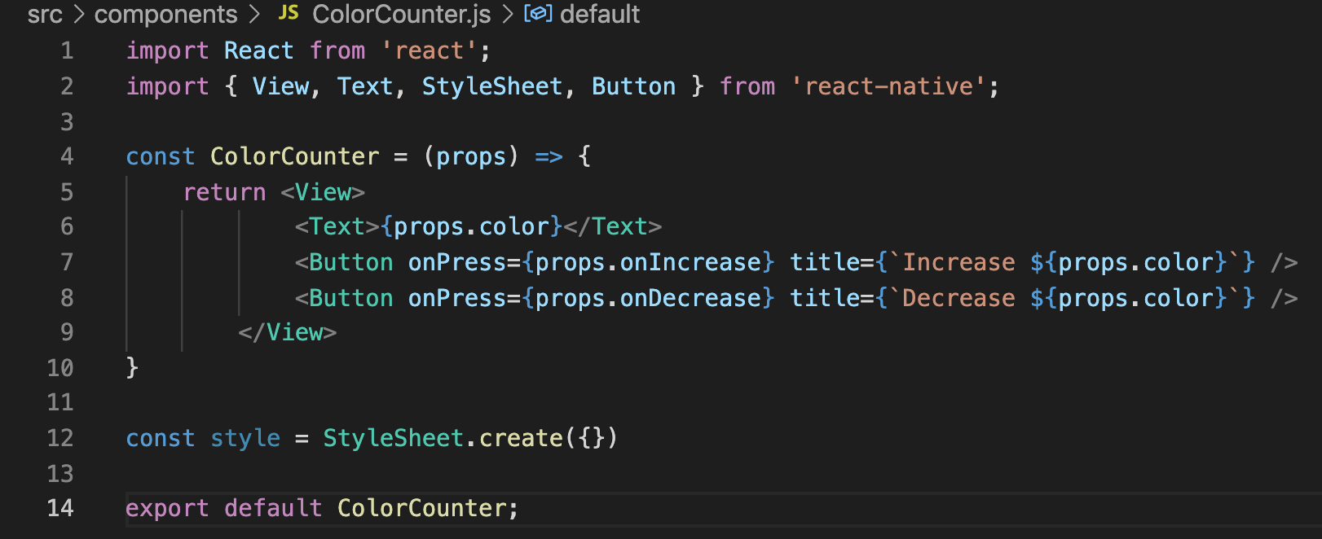
State and Props: Color Adjuster App
ColorCounter.js
We need to make it so that our components are actually using those functions!
So we do that by simply adding the onPress prop to our Buttons inside our ColorCounter.js files.

Slide 55
State and Props: Color Adjuster App
ColorCounter.js
With this, we’ve now given our child component the ability to invoke setSet
Either through invoking onIncresae or onDecrease.
That console.log line in SquareScreen.js should work now!

Slide 56
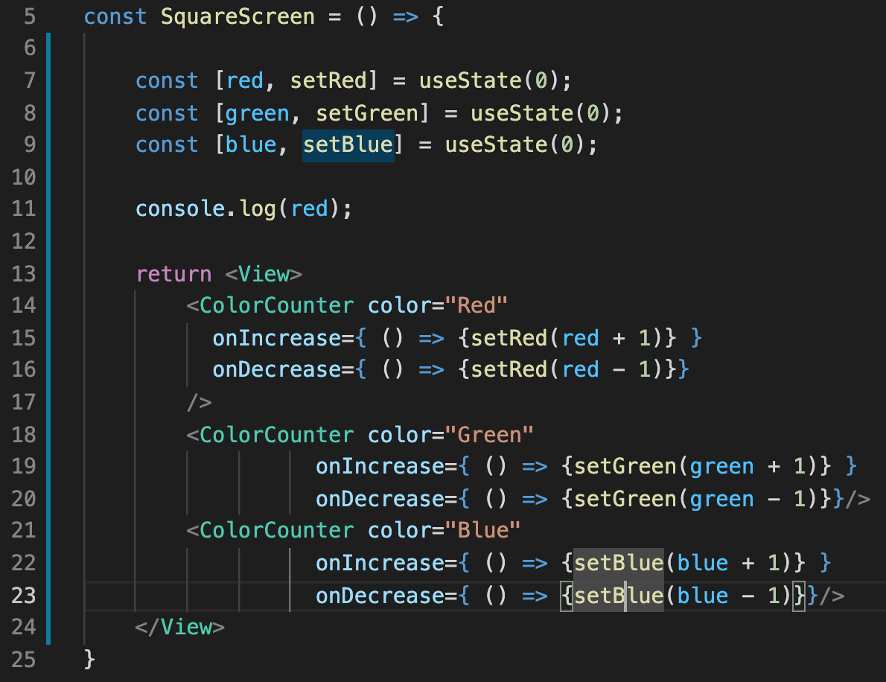

State and Props: Color Adjuster App
Before we forget: let’s add in those callback functions for our other ColorCounters.
Make sure you don’t forget to change the names of the setters to be appropriate!
SauareScreen.js

Slide 57
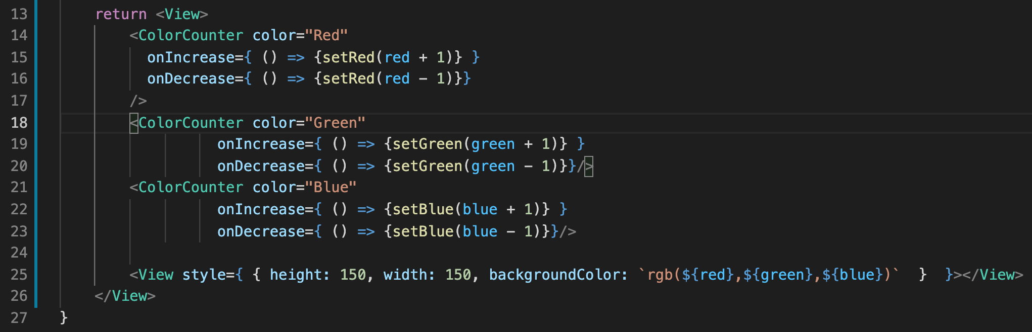
State and Props: Color Adjuster App
SquareScreen.js
And now let’s add in that final view so we can see the fruits of our labor!
We set it’s height and width to 150, as we’ve done before…
And we set it’s backgroundColor property using another string template!

Slide 58
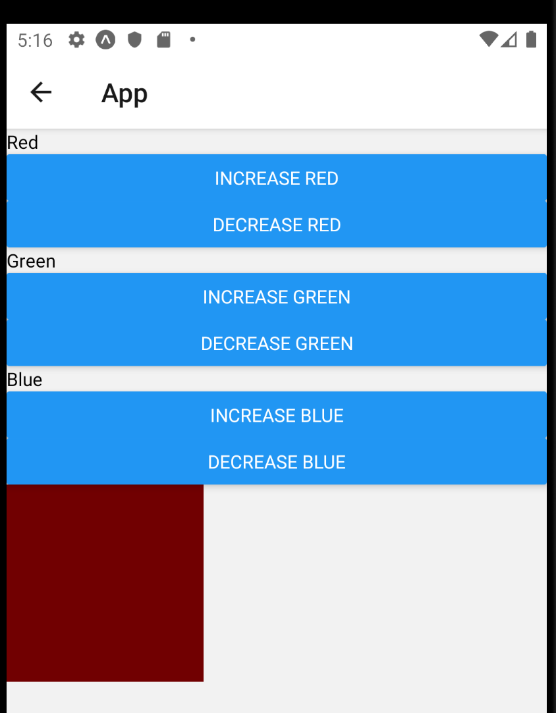
State and Props: Color Adjuster App
And now, we have a working little app!
Albeit: it is a slow working app!
Since we are only adjusting the colors by 1 each time, you need to click the buttons A LOT before the square stops looking black.
But if you are willing to do a lot of clicking, you’ll see that we’ve done it!
How might you make it go faster?

Slide 59
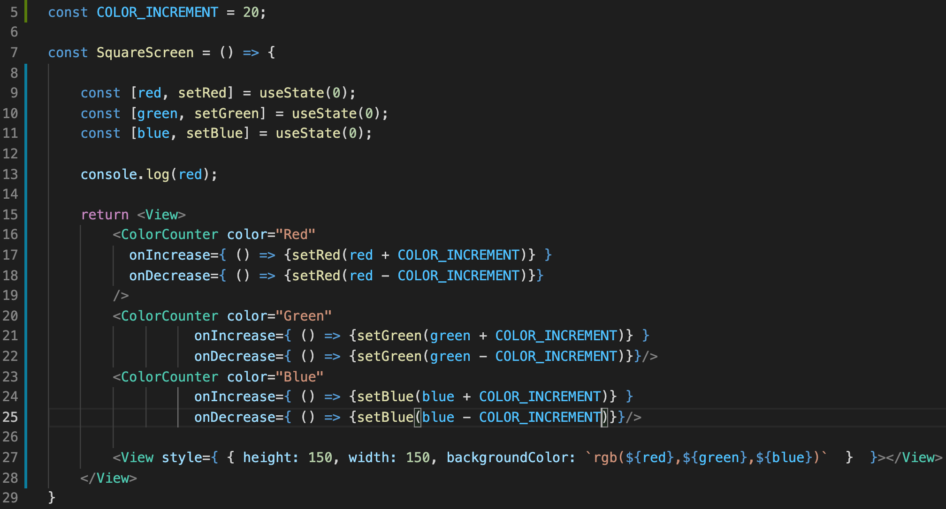
State and Props: Color Adjuster App
And now, we have a working little app!
Albeit: it is a slow working app!
Since we are only adjusting the colors by 1 each time, you need to click the buttons A LOT before the square stops looking black.
But if you are willing to do a lot of clicking, you’ll see that we’ve done it!
How might you make it go faster?
The cool way to do it!

Slide 60







State and Props: Color Adjuster App
We declare a new constant variable!
And now, we have a working little app!
Albeit: it is a slow working app!
Since we are only adjusting the colors by 1 each time, you need to click the buttons A LOT before the square stops looking black.
But if you are willing to do a lot of clicking, you’ll see that we’ve done it!
How might you make it go faster?
Which we then use any time we want to change the color value!
The cool way to do it!

Slide 61
State and Props: Color Adjuster App
Eliminates “magic numbers”
i.e., replacing literals in our code with variable names makes it easier to follow!
And makes it way easier to play around with different numbers! Only need to change one, not 6!
And now, we have a working little app!
Albeit: it is a slow working app!
Since we are only adjusting the colors by 1 each time, you need to click the buttons A LOT before the square stops looking black.
But if you are willing to do a lot of clicking, you’ll see that we’ve done it!
How might you make it go faster?
The cool way to do it!

Slide 62
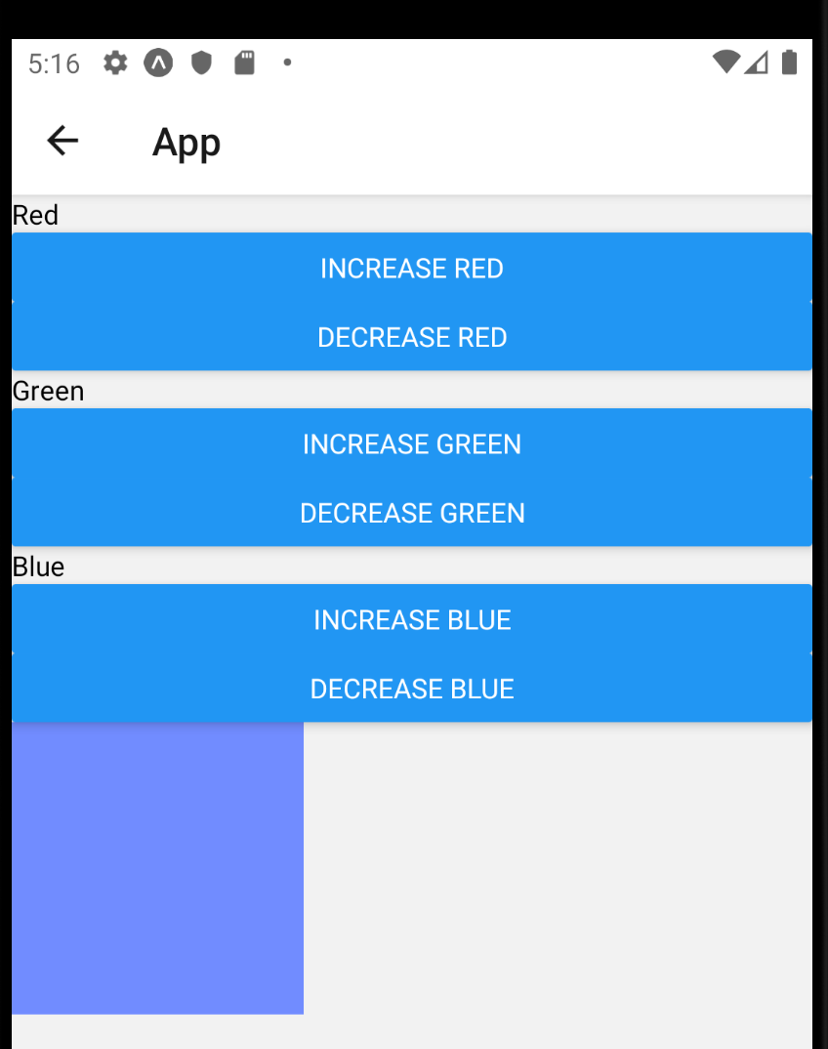
State and Props: Color Adjuster App
And now it’s way faster!
Lovely!

Slide 63
State and Props: Color Adjuster App
However, there’s something kind of weird going on:
Right now, our color numbers can go WAY below 0, or WAY above 255.
But we recall: the range that we can put into these color numbers should only be 0 to 255.
Take a few seconds to think: how might you solve this problem?
This is another one of the cases where the “most intuitive” way might not be the best way…

Slide 64
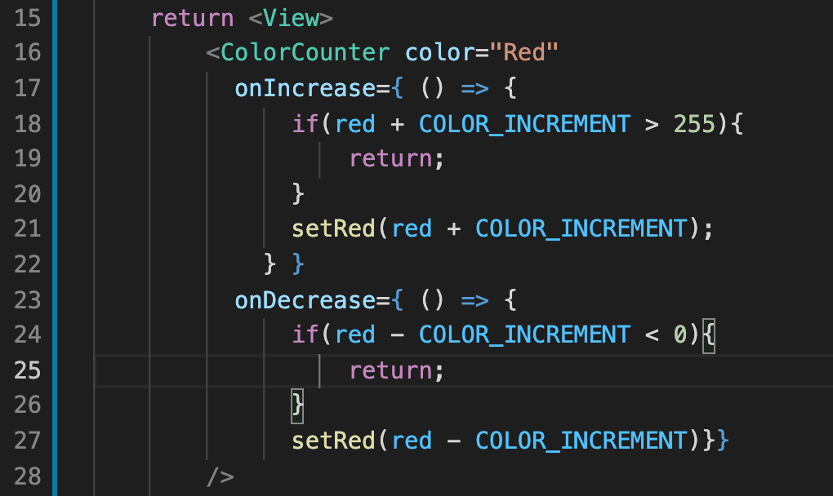
State and Props: Color Adjuster App
We could do something like this, right?
Just add in some conditional logic to check to see if adding / subtracting the decrement would cause a problem.
This would *totally work* but it’s a big of a shame…
Need to add basically the same code in six places.
Mixes validation logic with our JSX.

Slide 65
State and Props: Color Adjuster App
Instead of this, let’s make a helper function!
The goal of this helper function will be to be able to perform this validation logic for *any* color.

Slide 66
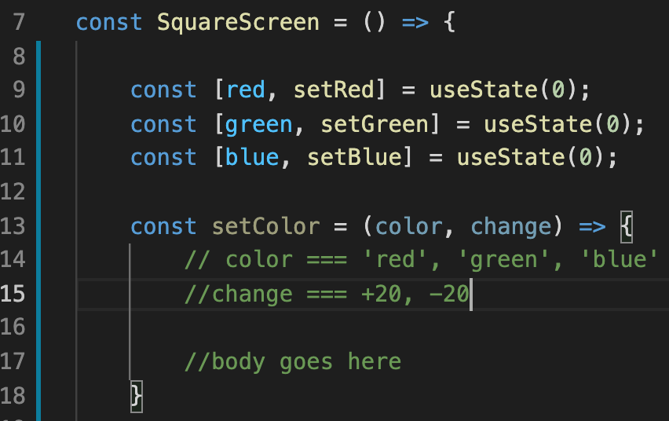
State and Props: Color Adjuster App
It will take in two arguments
color will be a string corresponding to which color we wish to increment.
change will be the amount we wish to change by.
SquareScreen.js

Slide 67
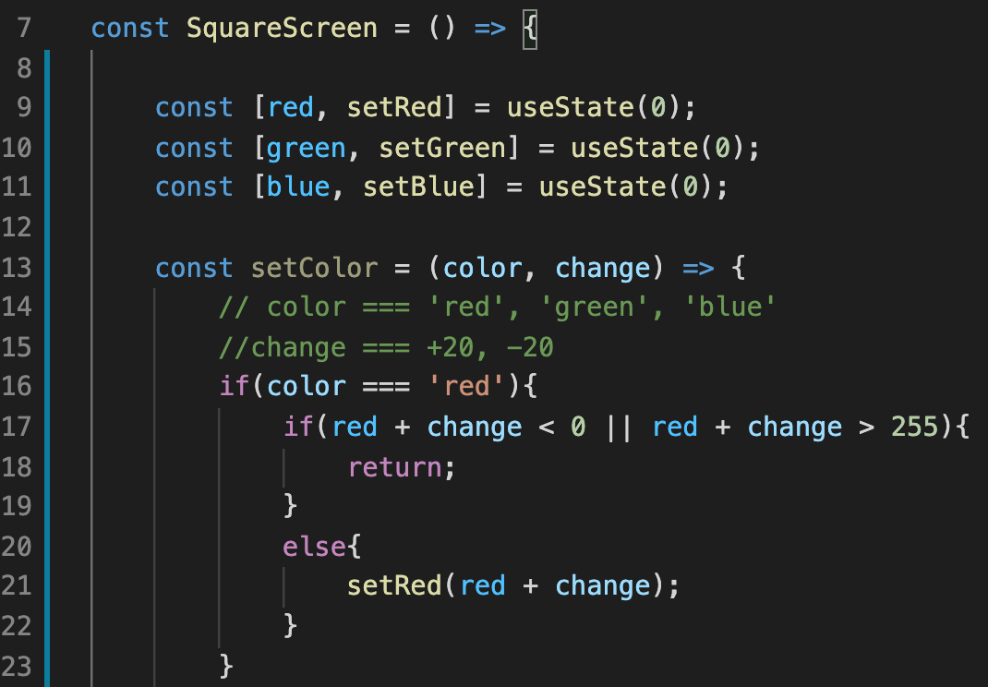


State and Props: Color Adjuster App
So we’ll start with just red, but eventually we’ll have three cases…
Where we just check to see which color we are working with..
And then based on that color, we check to see if it’s current value plus the change makes it go out of bounds.
If it does we return early.
Otherwise, we call our setter function to change its value.
SquareScreen.js

Slide 68
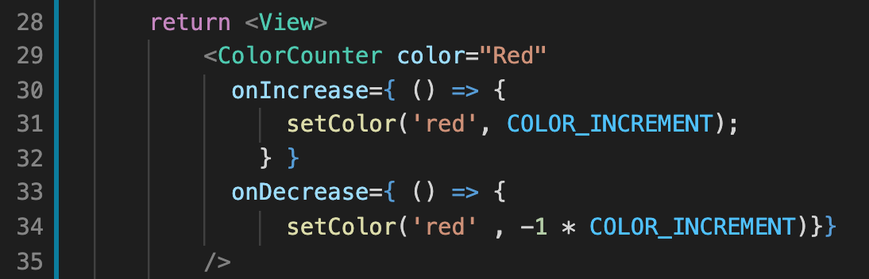
State and Props: Color Adjuster App
And now we invoke this method in our callback functions, instead of “setRed”
Note for onDecrease we need to multiply the COLOR_INCREMENT by -1.
SquareScreen.js

Slide 69
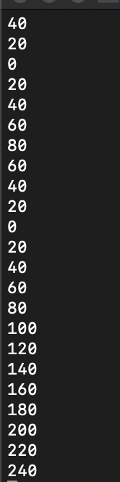
State and Props: Color Adjuster App
And it’s a little hard to convey with debug logs, but you’ll have to trust me…
If we try to make the value of red go below 0, it won’t do anything!
If we try to make it go above 255, it won’t do anything either!

Slide 70
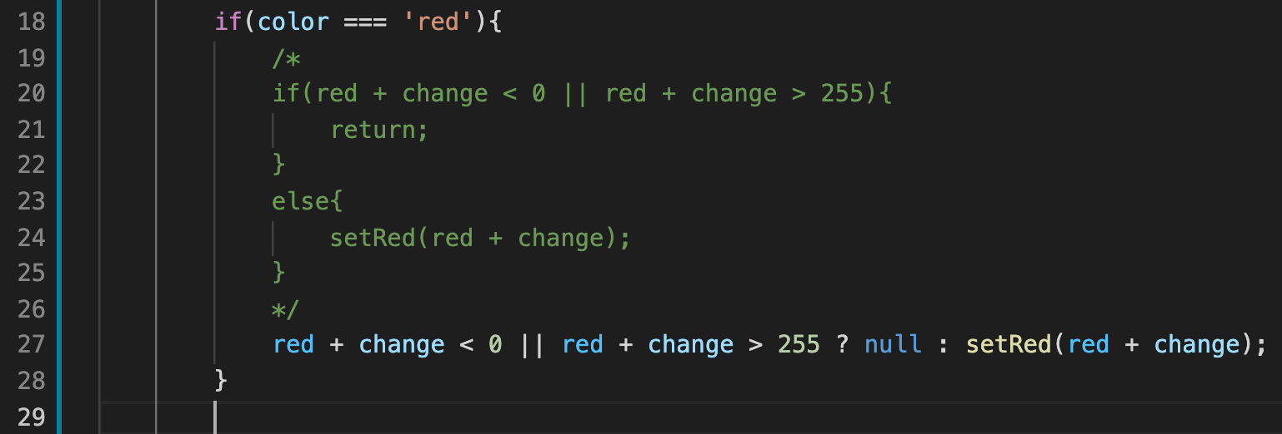
State and Props: Color Adjuster App
SquareScreen.js
Now, I’ll be honest with you guys, I like if statements.
I have no problems adding new line with abandon!
BUT, the ternary operator exists in JavaScript, and some would argue that it would be more appropriate to use in our validation logic.

Slide 71
State and Props: Color Adjuster App
SquareScreen.js
It’s the same as in other languages, but if you need a refresher…
The left hand side of the ‘?’ is something that evaluate to true or false.
If it evaluates to true, you do the thing to the left of the colon.
If it evaluates to false, you do the thing to the right of the colon.
So here: Is it out of range? Then do nothing. Othewise, call setRed.

Slide 72
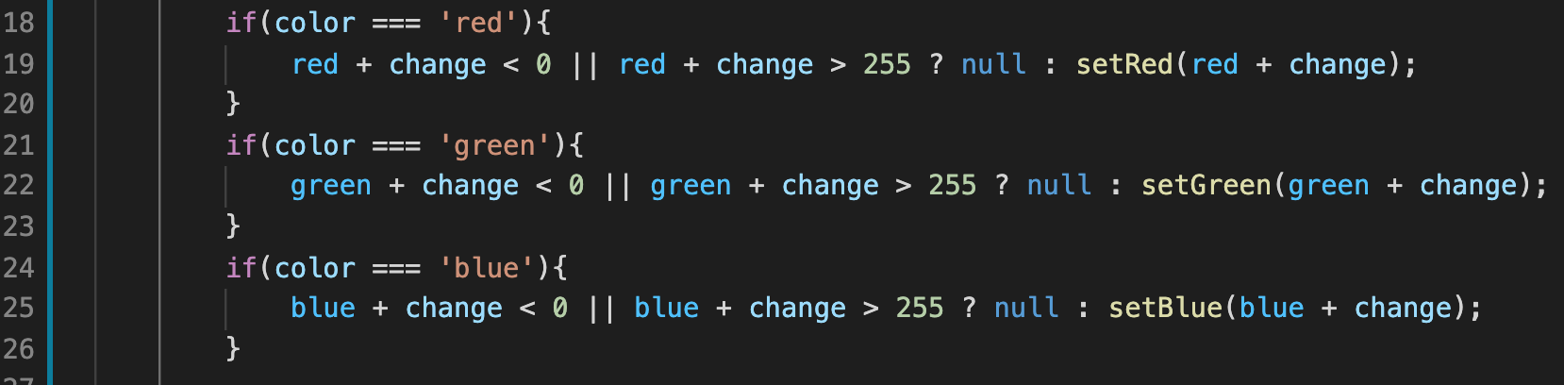
State and Props: Color Adjuster App
SquareScreen.js
Regardless of the technique you use, we’re now ready to handle the other color cases.
Make sure you update both the variable names and the setter function name for each case!
It’ll be four changes on each line ☺

Slide 73
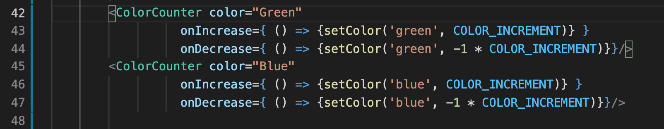
State and Props: Color Adjuster App
SquareScreen.js
And don’t forget to change your callback functions for green and blue to make use of our new setColor function as well!

Slide 74
State and Props: Color Adjuster App
And… that’s kind of it for today!
Today was less about learning new react native things, and was instead a nice reminder of various good software engineering practices!

Slide 75
State and Props: Color Adjuster App
And… that’s kind of it for today!
Today was less about learning new react native things, and was instead a nice reminder of various good software engineering practices!
We learned about the importance of utilizing the setter function that useState returns inside of callback functions that get passed down to child components via props!
That’s a mouthful!
And a react native thing.

Slide 76
State and Props: Color Adjuster App
But we also saw examples of separating out our validation logic from our render logic!
And avoiding using magic numbers!
And using the ternary operator!
Our code is now pretty to look at, and most importantly, easier to change!

Slide 77
State and Props: Color Adjuster App
That said, we can in theory make it *even better!*
And we’ll do so by introducing ”reducers” – our second hook!
See you all for part 3!

